Slide 1
Controlo
18
18 - 1

Slide 2
Objetivos
Explicar a natureza e a importância do controlo.
Descrever os três passos do processo de controlo.
Explicar como o desempenho dos empregados e o desempenho organizacional são medidos.
Descrever as ferramentas utilizadas para medir o desempenho organizacional.
Discutir tópicos atuais sobre controlo.
18 - 2

Slide 3
O que é o Controlo?
Controlo
Processo de monitorar, comparar e corrigir o desempenho.
Finalidade do controlo
  Assegurar que as atividades de trabalho são realizadas de modo a que os objetivos da organização sejam atingidos.
18 - 3
Notes:
What is controlling? It’s the process of monitoring, comparing, and correcting work performance. All managers should control even if their units are performing as planned because they can’t really know that unless they’ve evaluated what activities have been done and compared actual performance against the desired standard.
Effective controls ensure that activities are completed in ways that lead to the attainment of goals. Whether controls are effective, then, is determined by how well they help employees and managers achieve their goals.

Slide 4
Importância do Controlo
O controlo é o último elo de ligação nas funções de gestão e a sua importância é evidente nas seguintes áreas:
  Planeamento – o controlo permite aos gestores verificarem se os objetivos e planos estão a ser cumpridos e quais as ações a tomar no futuro.
  Empowerment – os sistemas de controlo fornecem informação e feedback sobre o desempenho dos empregados.
  Proteção do local de trabalho – o controlo possibilita a segurança física e reduz os incidentes negativos no local de trabalho.
18 - 4
Notes:
Why is control so important? Planning can be done, an organizational structure created to facilitate efficient achievement of goals, and employees motivated through effective leadership. But there’s no assurance that activities are going as planned and that the goals employees and managers are working toward are, in fact, being attained.
Control is important, therefore, because it’s the only way that managers know whether organizational goals are being met and if not, the reasons why. The value of the control function can be seen in three specific areas: planning, empowering employees, and protecting the workplace.
Many managers are reluctant to empower their employees because they fear something will go wrong for which they would be held responsible. But an effective control system can provide information and feedback on employee performance and minimize the chance of potential problems.
The final reason why managers control is to protect the organization and its assets. Today’s environment brings heightened threats from natural disasters, financial scandals, workplace violence, global supply chain disruptions, security breaches, and even possible terrorist attacks. Managers must protect organizational assets in the event that any of these things should happen.

Slide 5
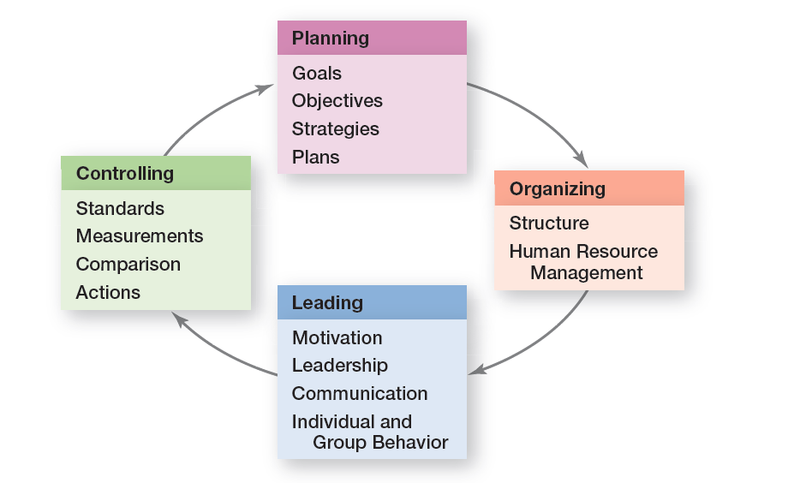
figura 18-1 ligação entre planeamento e Controlo
18 - 5
Notes:
Controlling provides a critical link back to planning (see Exhibit 18-1.) If managers didn’t control, they’d have no way of knowing whether their goals and plans were being achieved and what future actions to take.

Slide 6
Processo de controlo
Processo que inclui as seguintes três fases:
Medir o desempenho atingido.
Comparar o desempenho atingido com os standards de desempenho estabelecidos.
Implementar ações para corrigir os desvios encontrados ou os standards que não sejam adequados.
18 - 6
Notes:
The control process is a three-step process of measuring actual performance, comparing actual performance against a standard, and taking managerial action to correct deviations or to address inadequate standards. The control process assumes that performance standards already exist, and they do. They’re the specific goals created during the planning process.

Slide 7
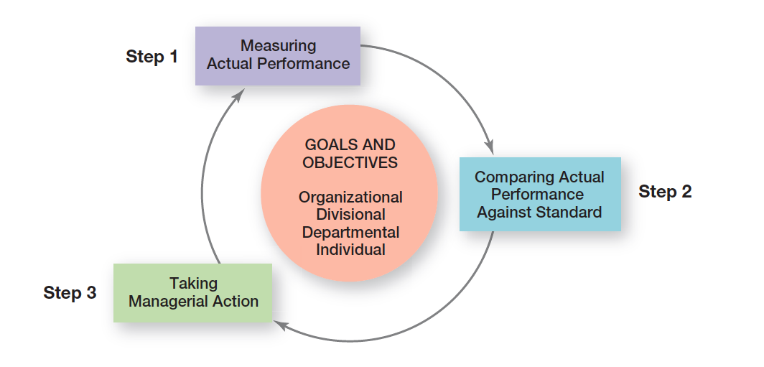
figura 18-2
Processo de Controlo
18 - 7

Slide 8
Processo de controlo (Cont.)
Fase 1: Medir o desempenho atingido
  Como medir: observação pessoal, relatórios estatísticos, relatórios orais e relatórios escritos.
  O que medir: Escolher o que vai ser medido é geralmente mais crítico do que escolher como vai ser medido. Aquilo que é medido pode determinar os aspetos em que os empregados se vão esforçar mais.
18 - 8
Notes:
To determine what actual performance is, a manager must first get information about it. Thus, the first step in control is measuring.
What is measured is probably more critical to the control process than how it’s measured. Why? Because selecting the wrong criteria can create serious problems. Besides, what is measured often determines what employees will do.
Most work activities can be expressed in quantifiable terms. However, managers should use subjective measures when they can’t. Although such measures may have limitations, they’re better than having no standards at all and doing no controlling.

Slide 9
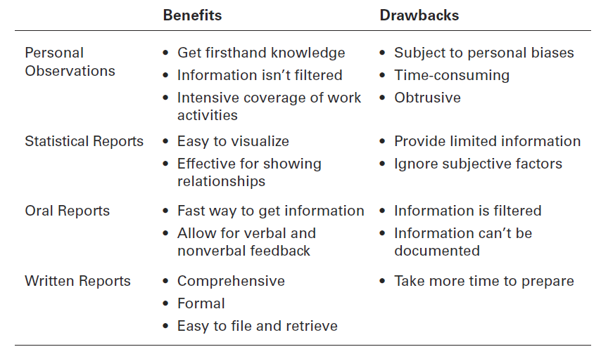
figura 18-3 fontes de Informação para medir o desempenho
18 - 9
Notes:
Four approaches used by managers to measure and report actual performance are personal observations, statistical reports, oral reports, and written reports. Exhibit 18-3 summarizes the advantages and drawbacks of each approach. Most managers use a combination of these approaches.

Slide 10
Processo de controlo (Cont.)
Fase 2: Comparar o desempenho atingido com o standard estabelecido
  Determinar o grau de variação entre o desempenho real e o standard estabelecido.
  Intervalo de variação – parâmetros de variação aceitável entre o desempenho e o standard.
18 - 10
Notes:
The comparing step determines the variation between actual performance and the standard. Although some variation in performance can be expected in all activities, it’s critical to determine an acceptable range of variation.

Slide 11
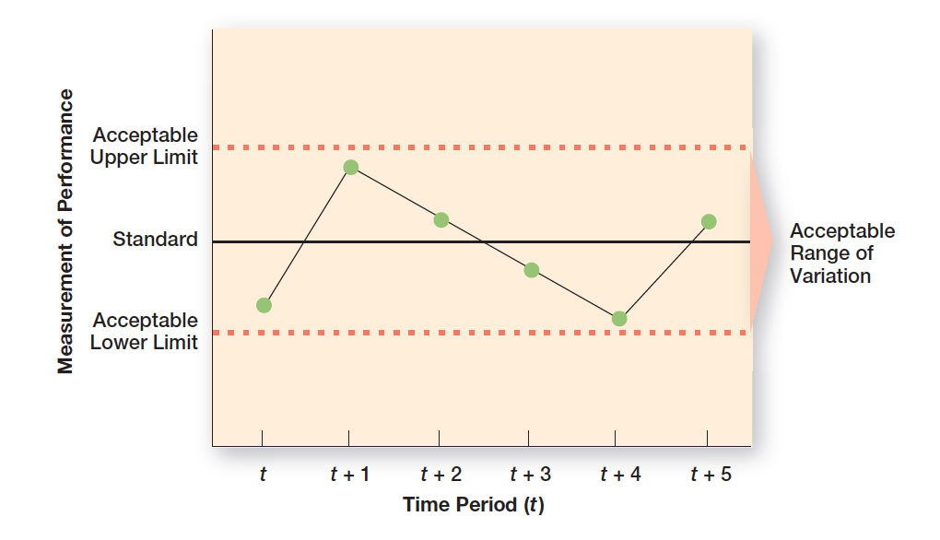
figura 18-4 intervalo de Variação aceitável
18 - 11

Slide 12
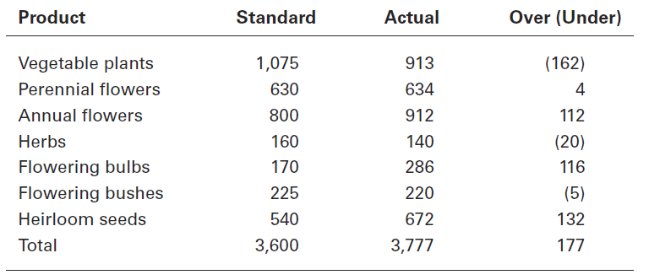
figura 18-5 vendas de junho da empresa
Green Earth Gardening
18 - 12
Notes:
Let’s work through an example. Chris Tanner is a sales manager for Green Earth Gardening Supply, a distributor of specialty plants and seeds in the Pacific Northwest. Chris prepares a report during the first week of each month that describes sales for the previous month, classified by product line. Exhibit 18-5 displays both the sales goals (standard) and actual sales figures for the month of June.
After looking at the numbers, should Chris be concerned? Sales were a bit higher than originally targeted, but does that mean there were no significant deviations? That depends on what Chris thinks is significant; that is, outside the acceptable range of variation. Even though overall performance was generally quite favorable, some product lines need closer scrutiny. For instance, if sales of heirloom seeds, flowering bulbs, and annual flowers continue to be over what was expected, Chris might need to order more product from nurseries to meet customer demand. Because sales of vegetable plants were 15 percent below goal, Chris may need to run a special on them. As this example shows, both overvariance and undervariance may require managerial attention, which is the third step in the control process.

Slide 13
Processo de controlo (Cont.)
Fase 3: Implementar ações
  Ações corretivas imediatas: corrigir os problemas para que o desempenho volte a níveis aceitáveis.
  Ações corretivas de base: identificar as causas que originaram os problemas e os desvios e, depois, corrigir essas causas.
18 - 13
Notes:
Managers can choose among three possible courses of action: do nothing, correct the actual performance, or revise the standards. Because “do nothing” is self-explanatory, let’s look at the other two.
One decision a manager must make is whether to take immediate corrective action, which corrects problems at once to get performance back on track, or to use basic corrective action, which looks at how and why performance deviated before correcting the source of deviation.

Slide 14
Processo de controlo (Cont.)
Fase 3: Implementar ações (cont.)
  Rever o standard de desempenho: pode ter sido estabelecido demasiado baixo/fácil e assim o desempenho ultrapassa sempre os objetivos.
  Nota: Os gestores têm de ter cuidado quando o standard é revisto para baixo.
18 - 14
Notes:
It’s possible that the variance was a result of an unrealistic standard—too low or too high a goal. In that situation, the standard needs the corrective action, not the performance. If performance consistently exceeds the goal, then a manager should look at whether the goal is too easy and needs to be raised. On the other hand, managers must be cautious about revising a standard downward.

Slide 15
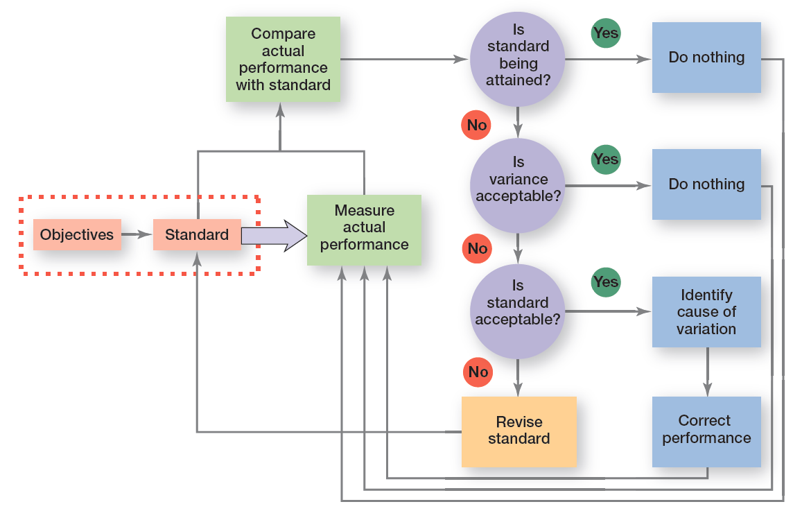
figura 18-6 decisões a tomar no processo de controlo
18 - 15
Notes:
Exhibit 18-6 summarizes the decisions a manager makes in controlling.

Slide 16
O que é o desempenho organizacional?
Desempenho
Resultado de uma atividade.
Desempenho organizacional
Resultados acumulados de todas as atividades de trabalho da organização
18 - 16
Notes:
Performance is the end result of an activity. And whether that activity is hours of intense practice before a concert or race or whether it’s carrying out job responsibilities as efficiently and effectively as possible, performance is what results from that activity.
Managers are concerned with organizational performance—the accumulated results of all the organization’s work activities. It’s a multifaceted concept, but managers need to understand the factors that contribute to organizational performance.

Slide 17
Medidas de desempenho organizacional
  Produtividade - rácio dos outputs (ex.: produtos ou serviços) pelos inputs necessários para atingir esses outputs (ex.: horas de trabalho).
Eficácia Organizacional – grau em que os objetivos foram atingidos.
  Rankings da indústria (ex.: crescimento; inquéritos à satisfação dos clientes; etc.)
18 - 17
Notes:
Productivity is the amount of goods or services produced divided by the inputs needed to generate that output. Organizations and individual work units want to be productive. They want to produce the most goods and services using the least amount of inputs. Output is measured by the sales revenue an organization receives when goods are sold (selling price × number sold). Input is measured by the costs of acquiring and transforming resources into outputs.
Organizational effectiveness is a measure of how appropriate organizational goals are and how well those goals are met. That’s the bottom line for managers, and it’s what guides managerial decisions in designing strategies and work activities and in coordinating the work of employees.

Slide 18
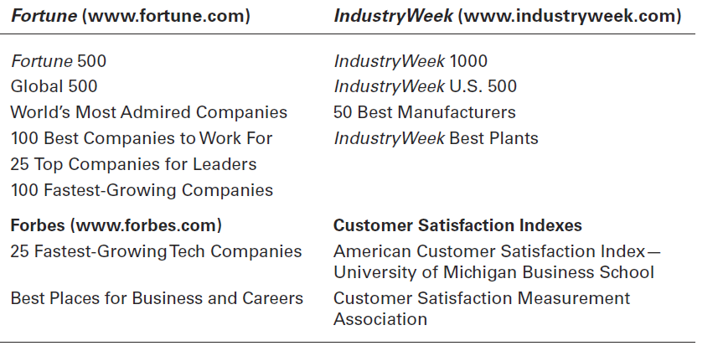
figura 18-7
Rankings mais conhecidos
18 - 18
Notes:
Rankings are a popular way for managers to measure their organization’s performance. And there’s not a shortage of these rankings as Exhibit 18-7 shows. Rankings are determined by specific performance measures, which are different for each list.

Slide 19
Controlo do desempenho dos empregados
Ações disciplinares
Ações dos gestores para reforçar os standards de trabalho e as regras da organização.
Fornecer feedback sobre desempenho – os gestores necessitam dar feedback aos subordinados para estes saberem como o seu trabalho está a ser avaliado.
18 - 19
Notes:
It’s particularly important for managers to deliver effective performance feedback and to be prepared, if needed, to use disciplinary actions—actions taken by a manager to enforce the organization’s work standards and regulation.
We like to know how we’re doing. Managers need to provide their employees with feedback so that the employees know where they stand in terms of their work. When giving performance feedback, both parties need to feel heard, understood, and respected. And if done that way, positive outcomes can result.

Slide 20
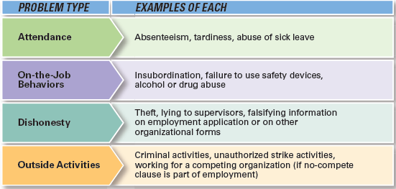
figura 18-8
Tipos de problemas de disciplina
18 - 20
Notes:
Exhibit 18-8 lists some common types of work discipline problems and examples of each. In those circumstances, it’s important for a manager to know what the organization’s policies are on discipline. Is there a process for dealing with unsatisfactory job performance? Do warnings need to be given when performance is inadequate? What happens if after the warnings, performance or the troublesome behavior doesn’t improve? Disciplinary actions are never easy or pleasant; however, discipline can be used to both control and correct employee performance, and managers must know how to discipline.

Slide 21
tipos de controlo
Controlo a priori (feedforward control) – antes da atividade ser realizada.
Controlo concorrente (concurrent control) – enquanto a atividade está em progresso.
Management by walking around – forma de controlo corrente através da supervisão direta das chefias.
Controlo a posteriori (feedback control) – depois da atividade ser realizada.
18 - 21
Notes:
The most desirable type of control—feedforward control—prevents problems because it takes place before the actual activity. The key to feedforward controls is taking managerial action before a problem occurs. That way, problems can be prevented rather than having to correct them after any damage (poor-quality products, lost customers, lost revenue, etc.) has already been done.
Concurrent control, as its name implies, takes place while a work activity is in progress.
The best-known form of concurrent control is direct supervision. Another term for it is management by walking around, which is when a manager is in the work area interacting directly with employees.
The most popular type of control relies on feedback. In feedback control, the control takes place after the activity is done. Feedback controls have two advantages. First, feedback gives managers meaningful information on how effective their planning efforts were. Feedback that shows little variance between standard and actual performance indicates that the planning was generally on target. Second, feedback can enhance motivation. People want to know how well they’re doing and feedback provides that information.

Slide 22
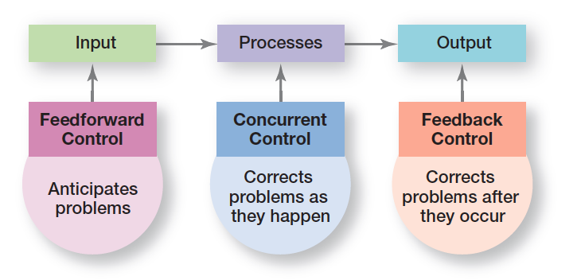
figura 18-9
Tipos de Controlo
18 - 22
Notes:
Managers can implement controls before an activity begins, during the time the activity is going on, and after the activity has been completed. The first type is called feedforward control; the second, concurrent control; and the last, feedback control (see Exhibit 18-9).

Slide 23
Controlos financeiros
Modos de Controlo Tradicionais
  Análise de rácios
    Liquidez
    Endividamento
    Atividade
    Rentabilidade
  Análise Orçamental
    Standards Qualitativos
    Desvios
18 - 23
Notes:
Every business wants to earn a profit. To achieve this goal, managers need financial controls. For instance, they might analyze quarterly income statements for excessive expenses. They might also calculate financial ratios to ensure that sufficient cash is available to pay ongoing expenses, that debt levels haven’t become too high, or that assets are used productively.
Budgets are planning and control tools. When a budget is formulated, it’s a planning tool because it indicates which work activities are important and what and how much resources should be allocated to those activities. But budgets are also used for controlling because they provide managers with quantitative standards against which to measure and compare resource consumption. If deviations are significant enough to require action, the manager examines what has happened and tries to uncover why.

Slide 24
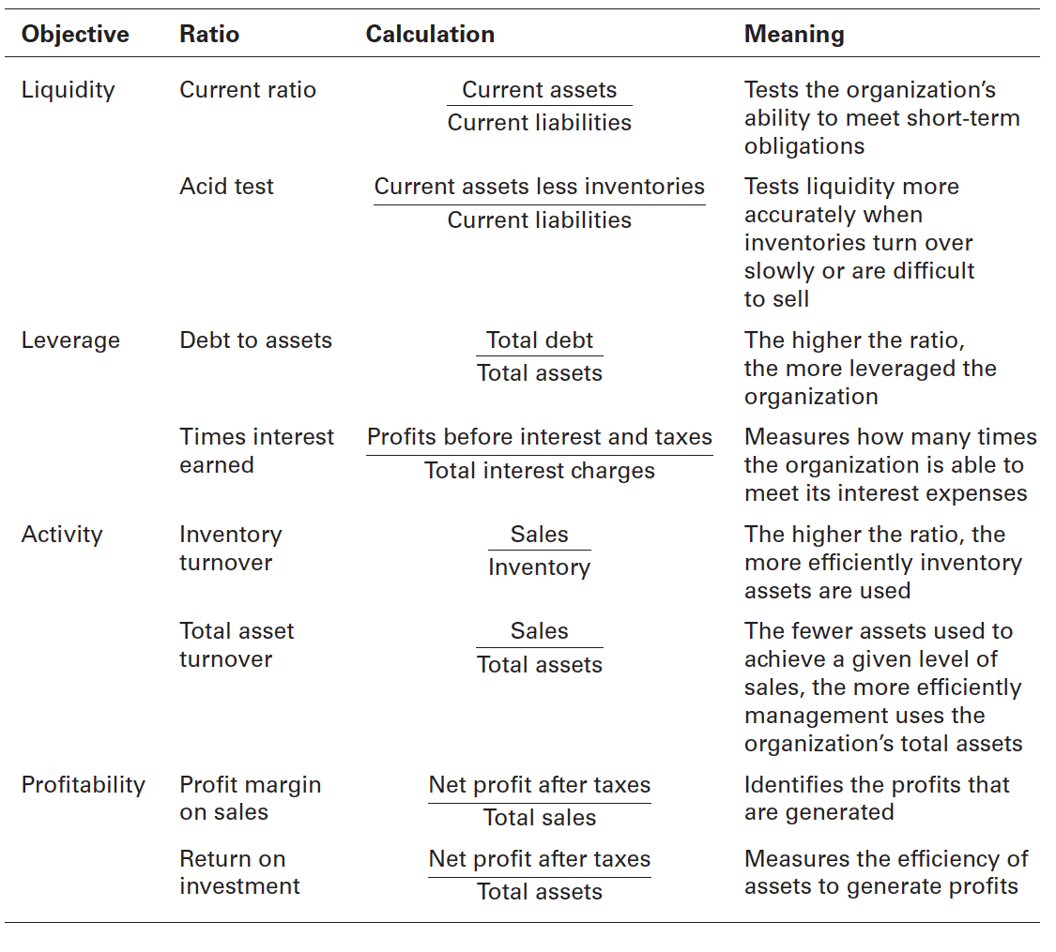
figura 18-10 rácios financeiros
18 - 24
Notes:
Managers might use traditional financial measures such as ratio analysis and budget analysis. Exhibit 18-10 summarizes some of the most popular financial ratios. Liquidity ratios measure an organization’s ability to meet its current debt obligations. Leverage ratios examine the organization’s use of debt to finance its assets and whether it’s able to meet the interest payments on the debt. Activity ratios assess how efficiently a company uses its assets. Finally, profitability ratios measure how efficiently and effectively the company uses its assets to generate profits. These ratios are calculated using selected information from the organization’s two primary financial statements (the balance sheet and the income statement), which are then expressed as a percentage or ratio.

Slide 25
Controlo da informação
Gestão de Sistemas de Informação
Management information system (MIS)
Sistema utilizado para fornecer aos gestores informação de modo regular.
Nota: Informação ≠ dados (a informação são dados já processados e analisados).
18 - 25
Notes:
In measuring actual performance, managers need information about what is happening within their area of responsibility and about the standards in order to be able to compare actual performance with the standard.
A management information system (MIS) is a system used to provide managers with needed information on a regular basis. In theory, this system can be manual or computer-based, although most organizations have moved to computer-supported applications. The term system in MIS implies order, arrangement, and purpose. Further, an MIS focuses specifically on providing managers with information (processed and analyzed data), not merely data (raw, unanalyzed facts).

Slide 26
Balanced Scorecard
Balanced scorecard
Ferramenta de mensuração do desempenho que investiga quatro áreas:
  - Finanças
  - Clientes
  - Processos internos
  - Recursos humanos, inovação e crescimento
Pretende enfatizar que todas as áreas são igualmente importante e que deve haver um equilíbrio entre elas.
18 - 26
Notes:
The balanced scorecard approach is a way to evaluate organizational performance from more than just the financial perspective.
A balanced scorecard typically looks at four areas that contribute to a company’s performance: financial, customer, internal processes, and people/innovation/growth assets. According to this approach, managers should develop goals in each of the four areas and then measure whether the goals are being met.

Slide 27
Benchmarking
Benchmarking
Identificação das melhores práticas, internas ou externas (dos concorrentes ou não-concorrentes), que estão a conduzir a um melhor desempenho.
Quando utilizado como ferramenta de controlo, o benchmarking estabelece os standards de desempenho.
18 - 27
Notes:
Benchmarking is the search for the best practices among competitors or noncompetitors that lead to their superior performance. Benchmarking should identify various benchmarks, the standards of excellence against which to measure and compare.

Slide 28
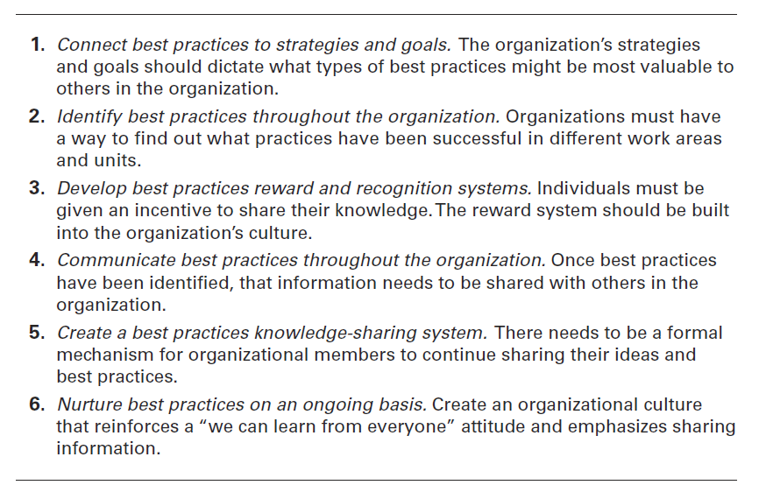
figura 18-11
Sugestões para Benchmarking Interno
18 - 28
Notes:
Sometimes those best practices can be found inside the organization and just need to be shared. Exhibit 18-11 provides some suggestions for internal benchmarking.

Slide 29
Tópicos atuais de controlo
Diferenças culturais:
  Os métodos de controlo variam de país para país.
  Os gestores têm de considerar a tecnologia disponível em cada país.
  - Os gestores têm de respeitar as restrições legais de cada país.
18 - 29
Notes:
The concepts of control that we’ve been discussing are appropriate for an organization whose work units are not geographically separated or culturally distinct. But control techniques can be quite different for different countries. The differences are primarily in the measurement and corrective action steps of the control process.
Managers in foreign countries also need to be aware of constraints on corrective actions they can take. Some countries’ laws prohibit closing facilities, laying off employees, taking money out of the country, or bringing in a new management team from outside the country.

Slide 30
Tópicos atuais de control (Cont.)
Privacidade
  Possibilidade dos gestores monitorarem as atividades dos empregados (sujeito a restrições legais):
    Ler o e-mail pessoal
    Escutas telefónicas
    Monitorar o trabalho através do computador
    Guardar dados pessoais (ex.: greves)
    Câmaras de vigilância na casa de banho ou vestiário
    Sistema de localização de veículos da companhia
18 - 30
Notes:
If you work, do you think you have a right to privacy at your job? What can your employer find out about you and your work? You might be surprised at the answers! Employers can (and do), among other things, read your e-mail (even those marked “personal or confidential”), tap your telephone, monitor your work by computer, store and review computer files, monitor you in an employee bathroom or dressing room, and track your whereabouts in a company vehicle.
And these actions aren’t that uncommon. In fact, some 26 percent of companies have fired an employee for e-mail misuse; 26 percent have fired workers for misusing the Internet; 6 percent have fired employees for inappropriate cell phone use; 4 percent have fired someone for instant messaging misuse; and 3 percent have fired someone for inappropriate text messaging.

Slide 31
Tópicos atuais de control (Cont.)
Furto – apropriação indevida de material da empresa para uso pessoal.
  Violência – A raiva ou frustração podem levar à violência, com consequências importantes sobre o clima organizacional e o desempenho. A estatísticas mostram que, todos os anos, mais de 2 milhões de Americanos são vítimas de violência no local de trabalho.
18 - 31
Notes:
Employee theft is defined as any unauthorized taking of company property by employees for their personal use. It can range from embezzlement to fraudulent filing of expense reports to removing equipment, parts, software, or office supplies from company premises. Managers need to educate themselves about this control issue and be prepared to deal with it.
Thankfully the number of workplace shootings has decreased. However, the U.S. National Institute of Occupational Safety and Health still says that each year, some 2 million American workers are victims of some form of workplace violence. In an average week, one employee is killed and at least 25 are seriously injured in violent assaults by current or former coworkers.

Slide 32
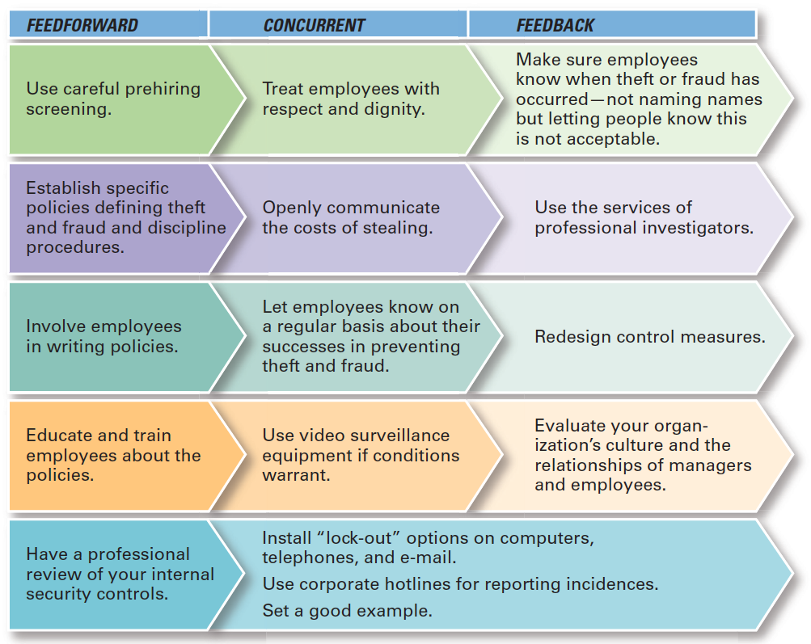
figura 18-12 controlo do furto
18 - 32

Slide 33
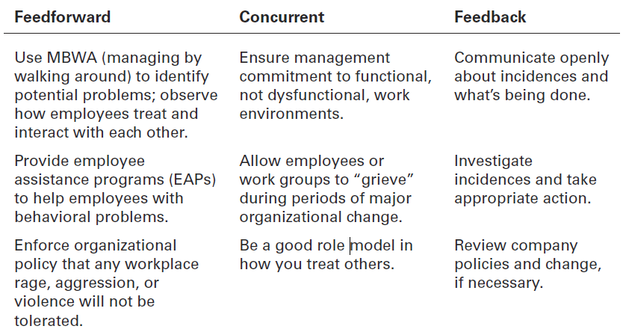
figura 18-13
Controlo da Violência
18 - 33
Notes:
What can managers do to deter or reduce possible workplace violence? Once again, the concept of feedforward, concurrent, and feedback control can help identify actions that managers can take. Exhibit 18-13 summarizes several suggestions.

Slide 34
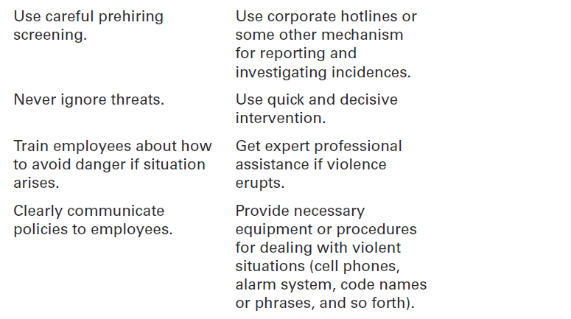
figura 18-13
Controlo da Violência
18 - 34

Slide 35
Tópicos atuais de control (Cont.)
Controlo das interações com os clientes
  Service profit chain
  Processo que liga os empregados aos clientes e estes ao desempenho organizacional.
18 - 35
Notes:
How can managers control the interactions between the goal and the outcome when it comes to customers? The concept of a service profit chain can help.
A service profit chain is the service sequence from employees to customers to profit. According to this concept, the company’s strategy and service delivery system influence how employees deal with customers; that is, how productive they are in providing service and the quality of that service.

Slide 36
Tópicos atuais de control (Cont.)
  Corporate governance
  Sistema utilizado para governar uma organização de modo a que os interesses dos seus proprietários sejam protegidos.
  Ex: Os gestores de topo são obrigados a certificar os resultados financeiros.
18 - 36
Notes:
Corporate governance, the system used to govern a corporation so that the interests of corporate owners are protected. It failed abysmally at Enron, as it has at many companies caught in financial scandals. In the aftermath of these scandals, corporate governance has been reformed.
The original purpose of a board of directors was to have a group, independent from management, looking out for the interests of shareholders who were not involved in the day-to-day management of the organization. However, it didn’t always work that way. Board members often enjoyed a cozy relationship with managers in which each took care of the other. The Sarbanes-Oxley Act puts greater demands on board members of publicly traded companies in the United States to do what they were empowered and expected to do.

Slide 37


